Slide 2
Application
Anti-lost belongings，eg：Mobile Phone、Key、Wallet、Umbrella、Suitcase and so on.
2020年
目标出货量：100万

Slide 3
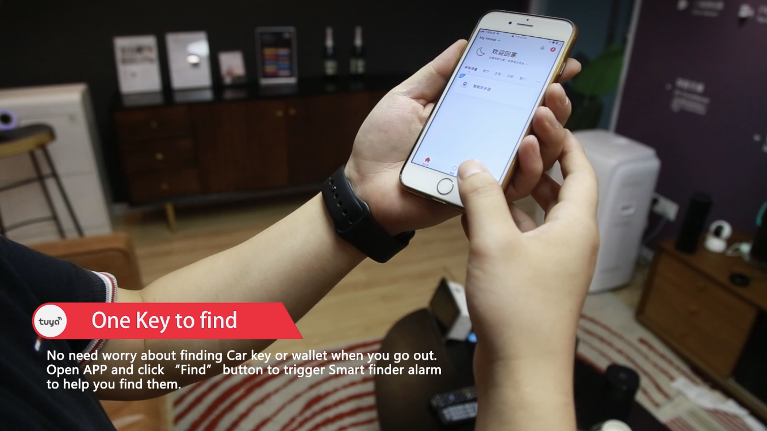
2020年
目标出货量：100万

Slide 4
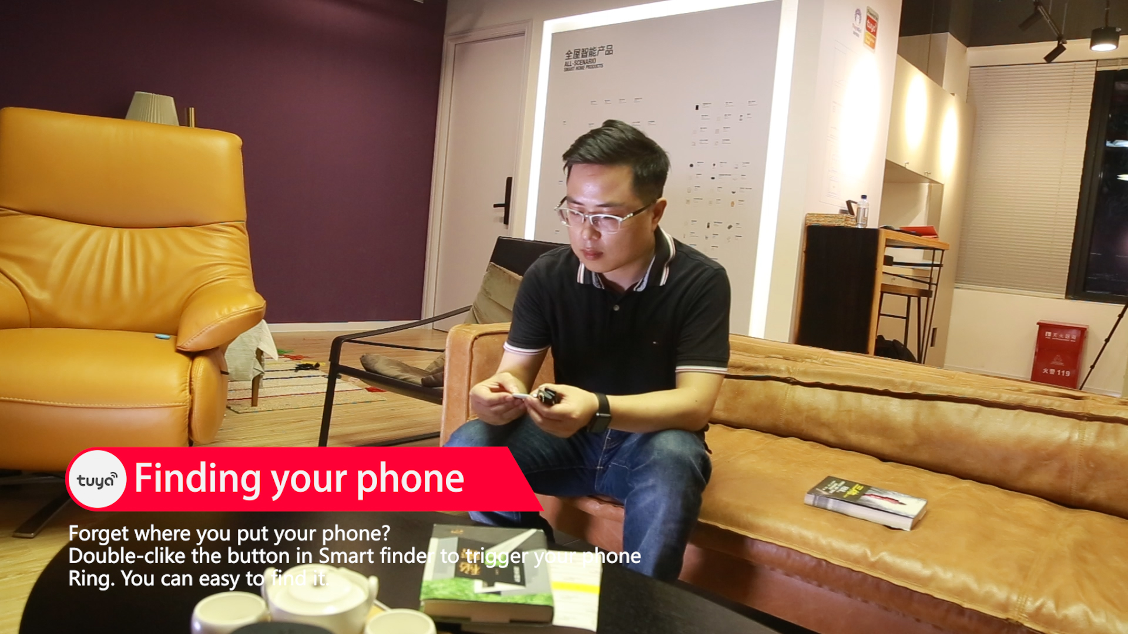

Slide 5
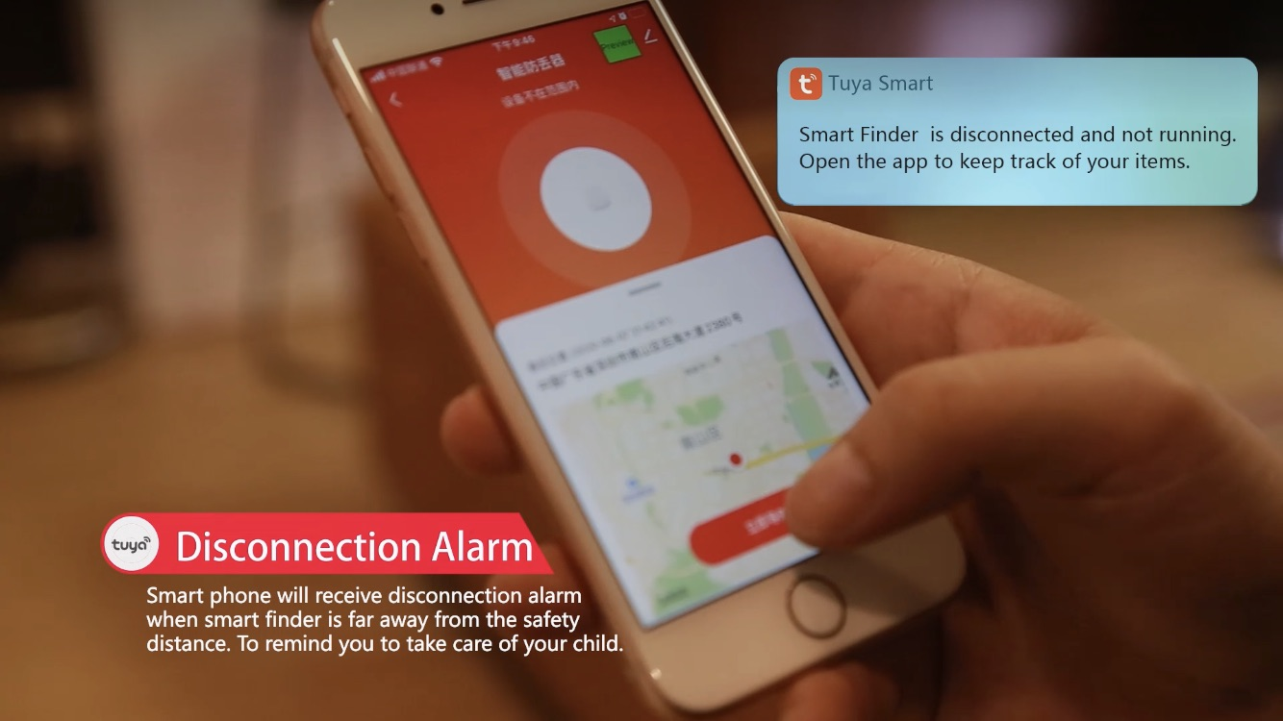
2020年
目标出货量：100万

Slide 6
2020年
目标出货量：100万

Slide 7
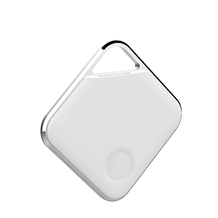
Appearance Design
● After sandblasting and oxidation, the aluminum alloy outer frame is treated with high gloss trimming.Simple and fashionable design.
2020年
目标出货量：100万

Slide 8
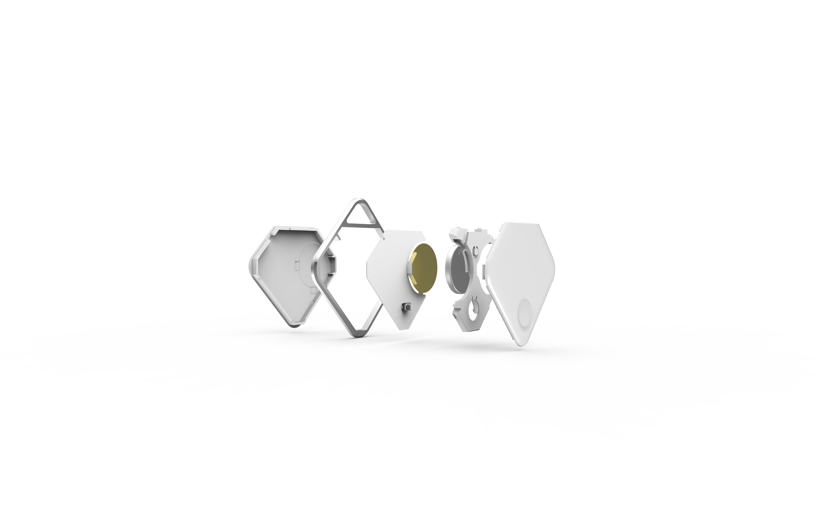
Hardware
● Built-in buzzer, the volume can reach 90dB, even in noisy environment, it can recognize the prompt tone.
● It adopts replaceable CR2032 battery for power supply, and it has stronger endurance.
● It uses bk3431q low-power Bluetooth chip with power optimization. It works 10-12 months normally.
2020年
目标出货量：100万

Slide 9
Hardware
● Built-in buzzer, the volume can reach 90dB, even in noisy environment, it can recognize the prompt tone.
● It adopts replaceable CR2032 battery for power supply, and it has stronger endurance.
● It uses bk3431q low-power Bluetooth chip with power optimization. It works 10-12 months normally.
2020年
目标出货量：100万

Slide 10
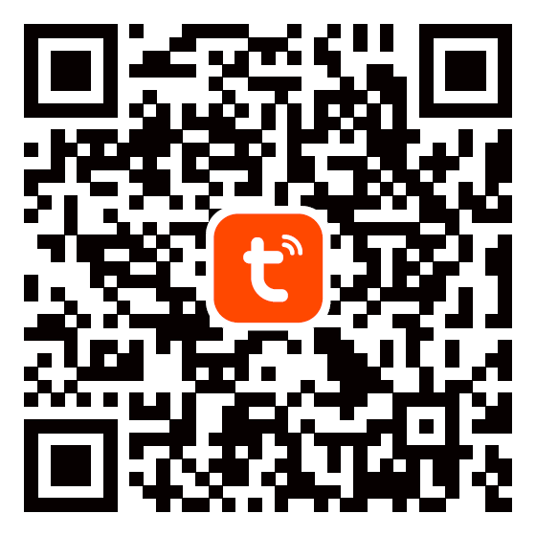
Product Specification
Items | Details
Color | Signal White
BLE Chipset | BK3431Q
Dimension | 45x45x6.5mm
Weight | 13.9g(With Battery)
Communication Protocol | BLE4.2
Battery | CR2032,220mAh
Rated Voltage | 3V
Radiate Power | 0dBm
Support OS | iOS 9.0+/Android 5.0+
Transmission Distance | 30~50m(Open)
Accessory | Lanyard
Lifespan | 12 Month
Working Temp | -20℃~60℃
2020年
目标出货量：100万
Download TUYA APP to simplely Login/register.
Add device to active your BLE Smart Finder

Slide 12
2020年
目标出货量：100万
THANKS

